Slide 1
INRODUCTION .
Here are the findings obtained from the data analysis of the two datasets that were being investigated . The findings are presented in different forms to enable readability and clear understanding .

Slide 2
BUSINESS UNDERSTANDING
Understanding the business help us know what is happening in the movie industry. As we situate the studio we need to know the top leading genres and what it takes to produce a movie . in addition to that we also need to know the leading studios ,this will help us know what to do in order to remain in the market where stiff competition rules people out.

Slide 3
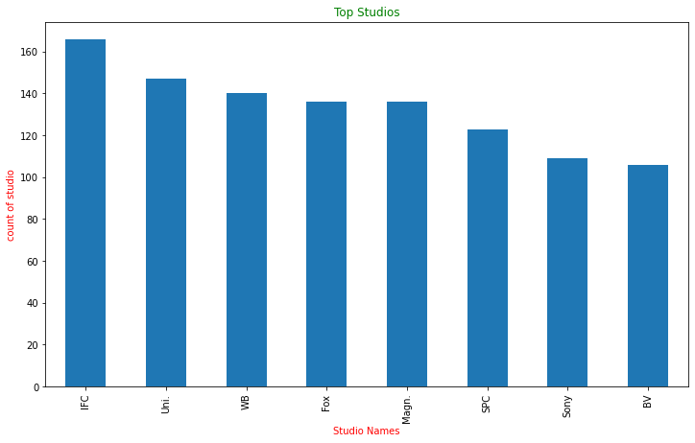
Leading studios
Below is a bar graph showing 8 of the leading studios

Slide 4
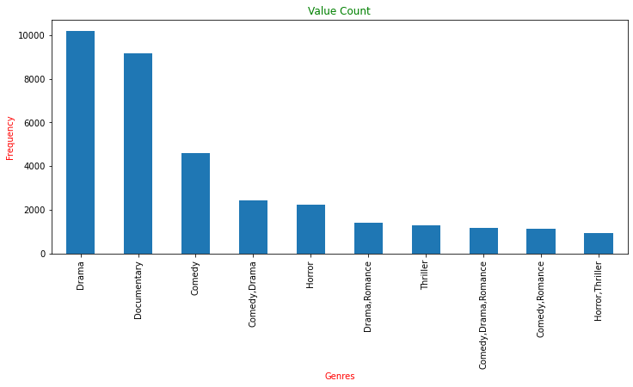
Leading genres
Below are some of the leading genres .Here are 10 of them .

Slide 5
Conclusion and findings
In conclusion ,Drama is the most popular genre, followed by comedy, comedy/Drama with the comedy,Romance and Horror Thriller being the least popular. In studio performance the IFC studio is the leading studio and Bv being the last according to our dataset.

